Slide 1
Paging Examples
Assume a page size of 1K and a 15-bit logical address space.
How many pages are in the system?

Slide 2
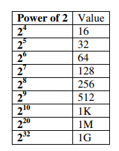
Answer: 2^5 = 32.
Assuming a 15-bit address space with 8 logical pages. How large are the pages?

Slide 3
Assuming a 15-bit address space with 8 logical pages. How large are the pages?
Answer: 2^12 = 4K. It takes 3 bits to reference 8 logical pages (2^3 = 8).
This leaves 12 bits for the page size thus pages are 2^12.

Slide 4
Consider logical address 1025 and the following
page table for some process P0.
Assume a 15-bit address space with a page size of 1K.
What is the physical address to which logical address 1025 will be mapped? RAM 64K
8
3
2

Slide 5
Consider logical address 1025 and the following
page table for some process P0. Assume a 15-bit address space with a page size of 1K. What is the physical address to which logical address 1025 maps?
8
3
2
Step 1. Convert 1025 to binary:
000010000000001 : P|D
1.1 : Calculate# of bits for pages and offset
Bits for page size(D) = 1K=2^10
=10 bits for offset (from 15 bit address)
Bits for Pages(P) = 15-10 ; 5 ;
= 5 bits for # of pages (15 bit address)
# of pages = 2^5 = 32 pages

Slide 6
Consider logical address 1025 and the following
page table for some process P0. Assume a 15-bit address space with a page size of 1K. What is the physical address to which logical address 1025 maps?
Step2. Determine the logical page number:
Since there are 5-bits allocated to the logical page & 10 bits for offset so the address is broken up as follows:
00001 0000000001
Logical page number offset within page
8
3
2

Slide 7
Consider logical address 1025 and the following
page table for some process P0. What is the physical address?
8
3
2
Step 3. Use logical page number as an index into the page table.
00001 0000000001
00001

Slide 8
Consider logical address 1025 and the following
page table for some process P0. What is the physical address?
Assume 64K memory size.
64K bit memory = 2^6. 2^10
=2^ 6+10=2^16
physical Address = 16 bits F|D
Offset(D) bits = 10 bits already calculated
Frames bits= 16-10 = 6 bits
Number of frames = 2^6
= 64 frames(of 1K each)
8
Frame Number 3
2
Page number 00001
Take the physical frame number which is 3 for page number 1 from the page table and concatenate the offset.
000011 0000000001 F|D (16 bit)
physical address = 3073

Slide 9
What is size of page table?
Already Calculated :
Number of pages = 2^5 = 32 pages(0f 1K each)
Number of frames = 2^6 = 64 frames(of 1K each)
Hence 6 bits required to store frames in page table. It will take 1 byte(8 bits) to store 6 bits. Therefore size of each entry in page table would be 1 byte.
Size of Page table = (total number of page table entries) * (size of a page table entry)
= (2^5) * 2 ^1
=2^ 5. 2^1
=32 * 1 = 32 bytes

Slide 10
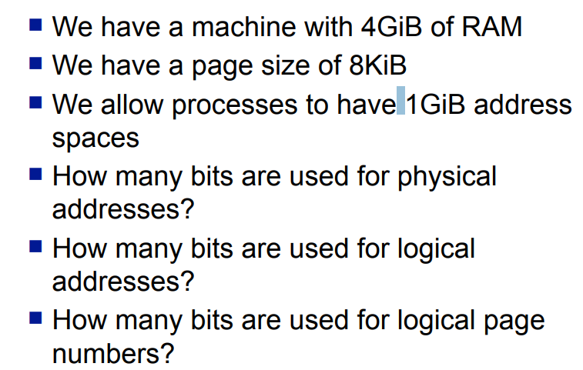
Problem 1:

Slide 11
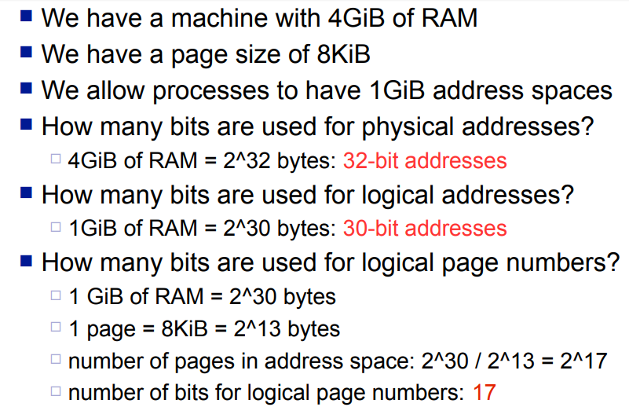
Problem 1 Solution:

Slide 12
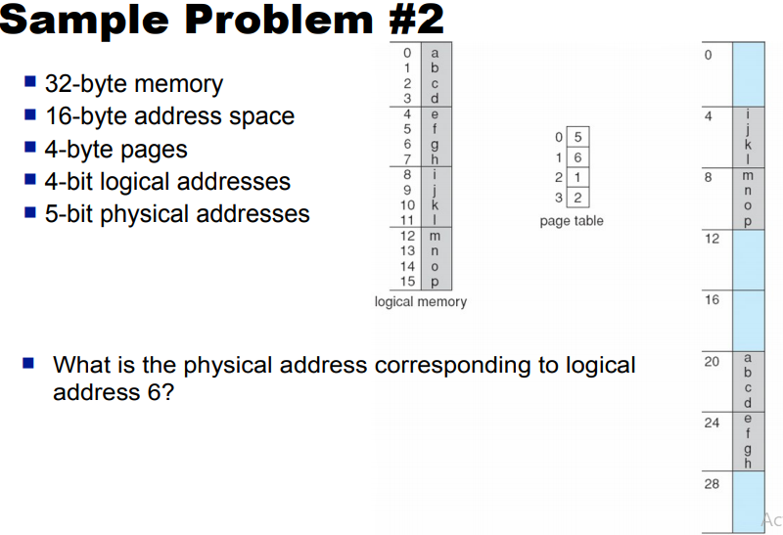

Slide 13
